Slide 1



OLA Ride Booking Analysis Dashboard
Presented by Siddartha Reddy
Under the Guidance of
SHADIYA P P

Slide 2



Abstract
The Ola Ride Booking Analysis Dashboard is designed to analyze ride booking data and generate meaningful business insights using Power BI. The project focuses on understanding booking trends, customer behavior, vehicle performance, revenue generation, ride cancellations, and customer satisfaction. By transforming raw ride data into interactive visualizations, the dashboard enables better decision-making and helps identify patterns that can improve operational efficiency, enhance customer experience, and support business growth. This project demonstrates the practical application of data analytics, SQL, and Power BI in solving real-world transportation and mobility challenges.

Slide 3
Problem Statement
Large volumes of ride booking data make manual analysis difficult and time-consuming.
Business insights related to bookings, cancellations, revenue, and customer satisfaction are not easily visible from raw data.
An interactive Power BI dashboard is needed to transform raw ride data into actionable insights for better decision-making.

Slide 4
Data Cleaning &
Preprocessing
Raw Dataset
(103,024 Records)
Booking Status
Standardized Categories
Removed Duplicate Records
Vehicle Type
Handled Missing Values
Month
Created New Features
Date
Converted Date & Time Formats
Hour
Dataset Ready

Slide 5
Streamlit Dashboard Overview
Developed an interactive Streamlit application to analyze Ola ride booking data.
Integrated SQL queries and visualizations to generate business insights from the dataset.
Implemented dynamic filters and charts for analyzing bookings, revenue, ratings, and cancellations.
Created a user-friendly dashboard that enables real-time data exploration and decision-making.

Slide 6
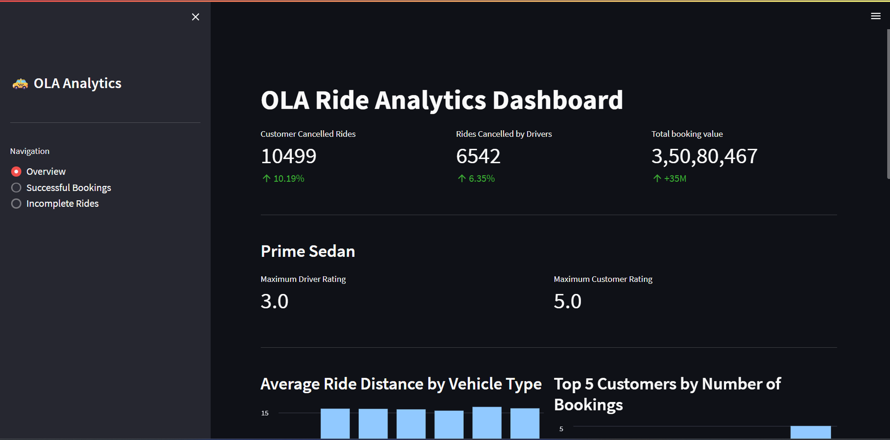
Streamlit Dashboard Overview

Slide 7
Power Bi Dashboard Overview
Designed an interactive Power BI dashboard to visualize ride booking data and key business metrics.
Created insightful visualizations for ride volume, booking status, revenue, customer ratings, and cancellations.
Utilized DAX measures and Power Query transformations to enhance data analysis and reporting.
Enabled data-driven decision-making through interactive filters, KPIs, and dynamic reports.

Slide 8
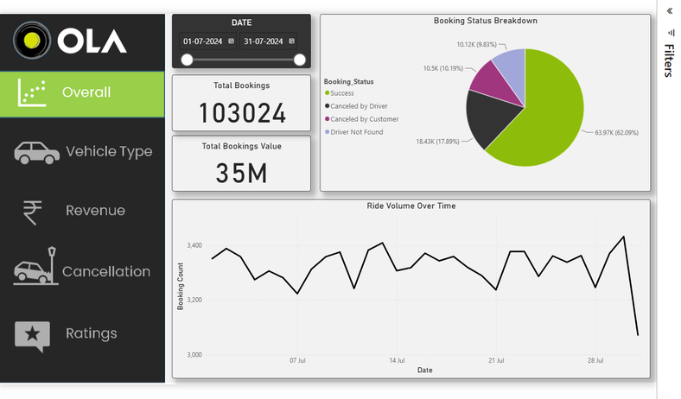
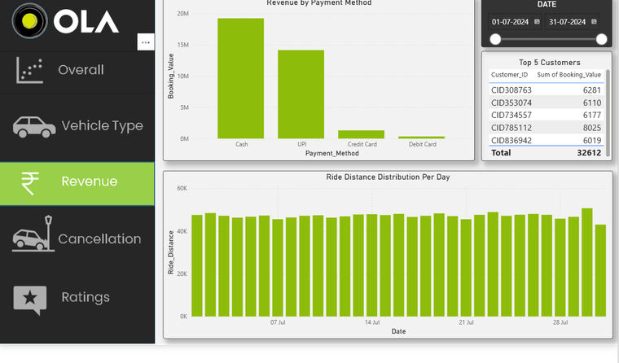
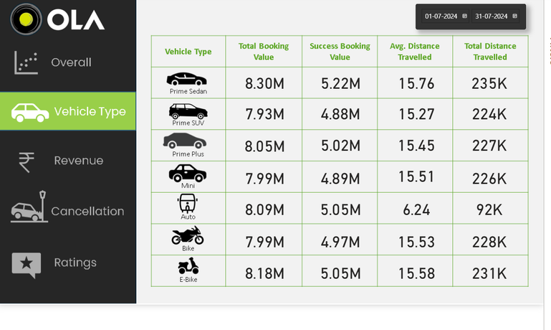
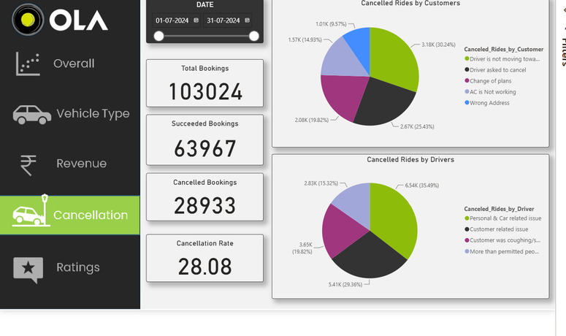
Power Bi Dashboard Overview

Slide 9
Conclusion & Future Scope
Conclusion
Successfully analyzed ride booking data using SQL, Power BI, and Streamlit.
Generated actionable business insights through interactive dashboards.
Improved understanding of customer behavior and operational performance.
Future Scope
Real-time dashboard integration.
Predictive analytics for ride demand forecasting.
Customer churn prediction.
Driver performance optimization.

Slide 10
Thank You

